Slide 1
Machine Vision COMP 0137
Dr. Gabriel Brostow
Dept. Computer Science
University College London
http://www.cs.ucl.ac.uk/staff/g.brostow/

Slide 2
Schedule
Office Hours
Tue’s 11-12pm
<Zoom>
LECTURES
Mondays: 1-2pm in Roberts 106
Tuesdays: 10-11am <Zoom>
Thursdays: 9-10am Roberts 106
PRACTICAL SESSIONS
Wednesdays 11am-14 <Zoom / Malet Place Eng Bldg 1st floor>
Teaching Assistants (TA’s)
Gizem Unlu
Matthew Sargent
Mirgahney Mohamed
Maria Miscouridou
Elliott Macneil
Maria Stamatopoulou
Nishant Gautam
Omiros Pantazis

Slide 3
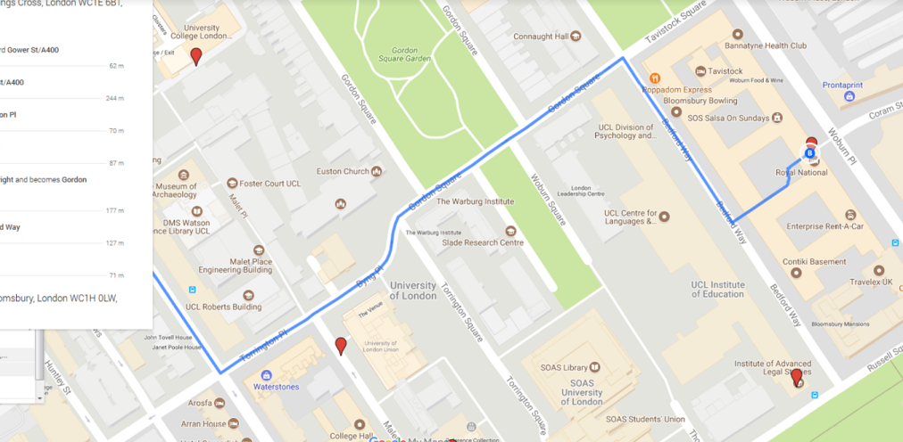
Schedule
LECTURES
Tuesday : 10-11am Gordon Square(24), room 105
Thursday: 2-3pm Anatomy B15
Friday: 1-2pm: Malet Place 1.02
PRACTICAL SESSIONS
Thursday 3-6pm DMS Watson G15 - Public Cluster**
Demonstrators:
Oisin Mac Aodha
Michael Firman
Clément Godard
Find them by email

Slide 4
Materials
Lecture Notes (now in book form)
Slides
Key Papers
Labs

Slide 5
Time Commitment
30 x 1-hour lectures
10 x 3-hour labs – do the programming practicals
Expect to spend 10 hours a week on:
Reading book, reviewing class notes
Working through proofs and implementing algorithms

Slide 6
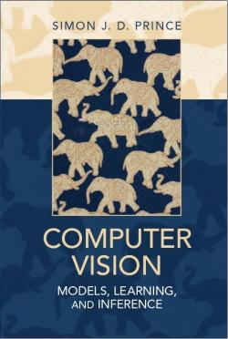
Our Book(s)
By Simon Prince, ex-UCL
Mainly
Computer Vision Models
Online here:
http://www.computervisionmodels.com/
(Also using Simon Prince’s slides (thanks Simon!))
Now also trialling content from Simon’s
“Understanding Deep Learning”

Slide 7

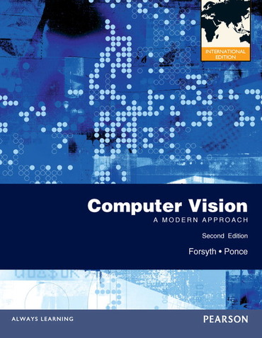
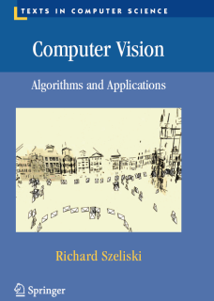
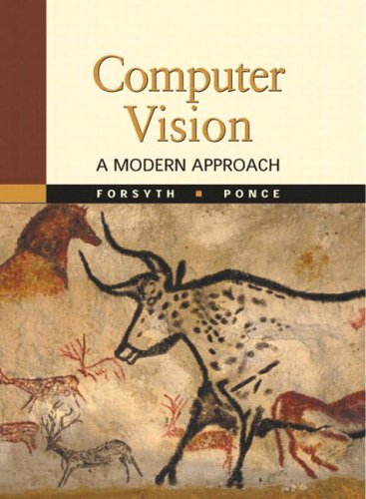
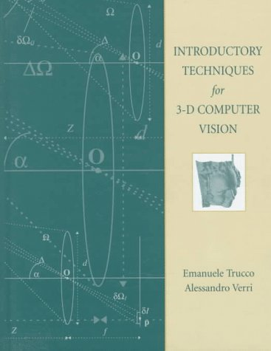
Other Books

Slide 8
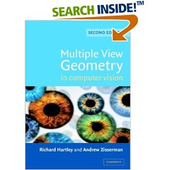

Other Books
Good for geometry (1 free chapter online)
Good for tracking (free online)

Slide 9
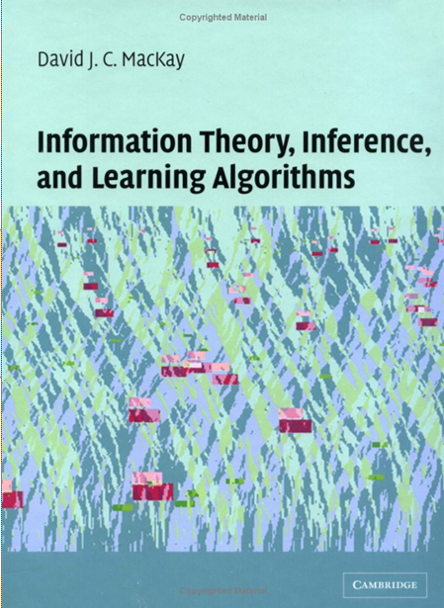
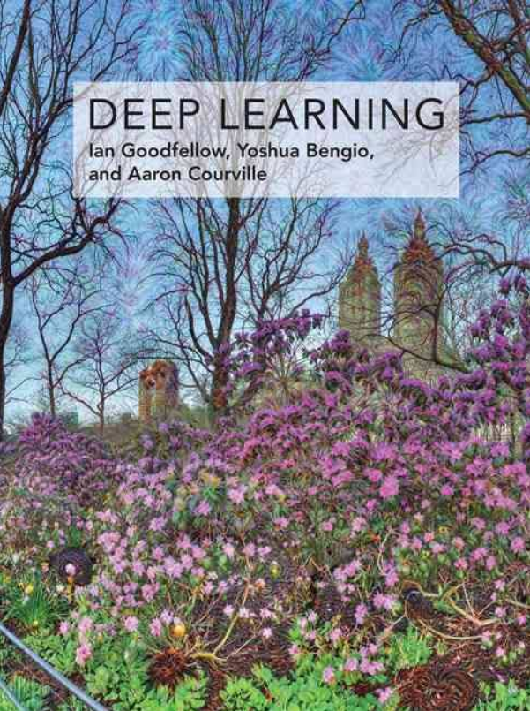
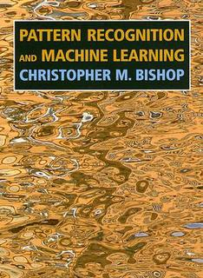
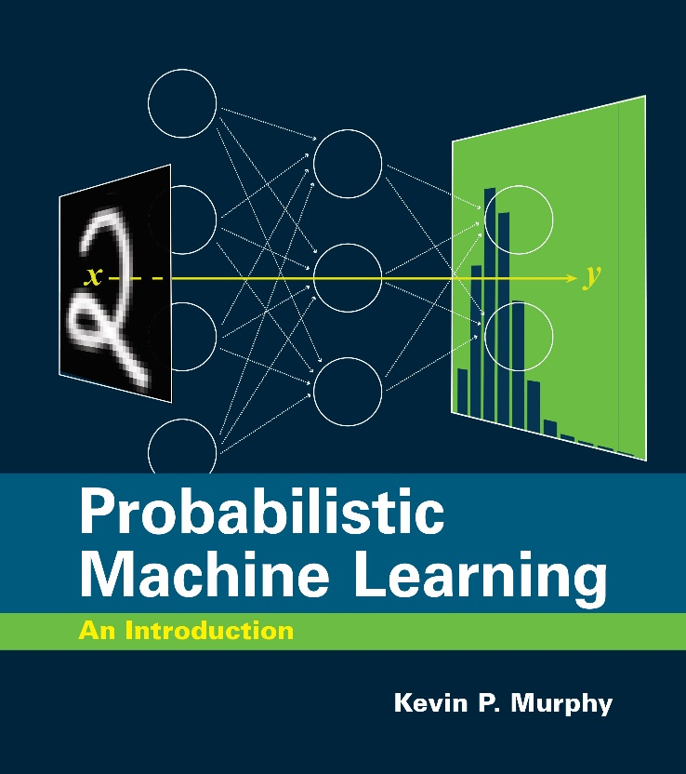
Other Books

Slide 10
Useful Knowledge
Linear Algebra up to and including the Singular Value Decomposition
Calculus including partial derivatives

Slide 11
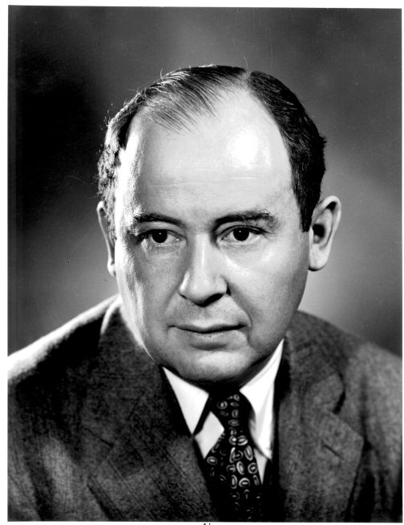
Problems
"In mathematics you don't understand things. You just get used to them."
John Von Neumann, 1903-1957
How to get used to them?
Do problems from the appropriate book. Implement the algorithms in the lecture notes. Work through the proofs in the text and appendices. Familiarity and understanding of mathematics only comes with use.

Slide 12
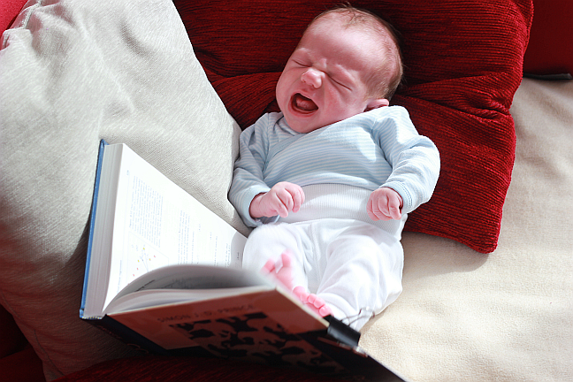
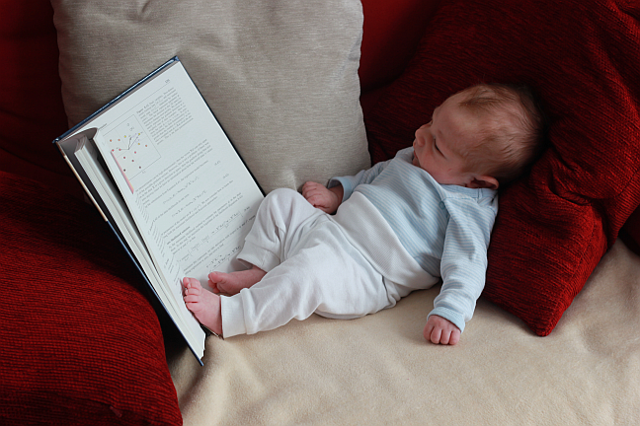
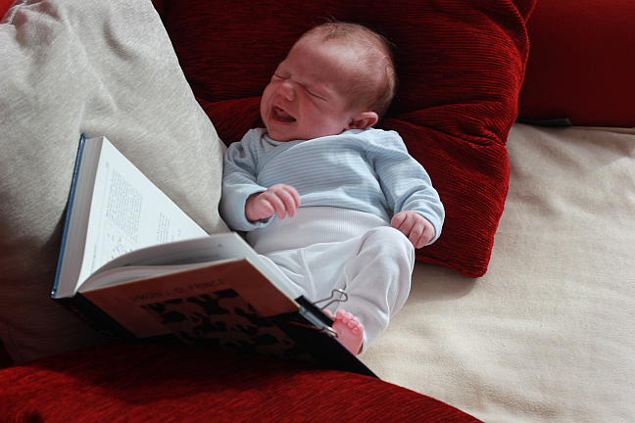
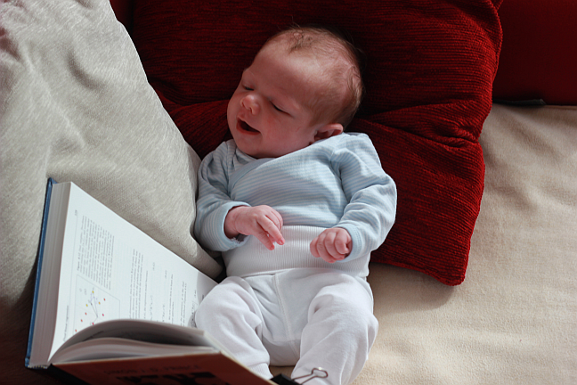
Problems
"In mathematics you don't understand things. You just get used to them."
John Von Neumann, 1903-1957
How to get used to them?
Do problems from the appropriate book. Implement the algorithms in the lecture notes. Work through the proofs in the text and appendices. Familiarity and understanding of mathematics only comes with use.

Slide 13
Exam
80% of overall grade
Probably 2 or 2.5 hours
Online, multiple choice and short answer
The exam is in/near late May

Slide 14
Practical Classes
11am-14:00 Thursdays
A new assignment in each class, should be able to complete within the class
Both myself and TA’s will attend each session
All assignments in Python
(Attendance register will be taken?)
(In-person 50-100% of the time)

Slide 15
Practical Classes
Supporting materials available from the COMP0137 Moodle website.
Topics (Provisional):
Introduction to Python
Fitting probability distributions
Regression
Classification
Dynamic Programming
Markov Random Fields
Geometry of multiple cameras
Homographies + Augmented Reality
Tracking with Particle Filters
Neural Networks

Slide 16
Coursework
To complete COMP0137 Machine Vision, you must complete two assignments. Both consist of write-ups from the practical sessions. However, I won’t tell you which ones until nearer the time. One is due at the end of Reading Week. The other is due at the beginning of next term.
Practical 1: Programming Assignment 1
Deadline: 19th November (provisional)
Practical 2: Programming Assignment 2
Deadline: 13th January (provisional)
We are following UCL’s “Standard Late Policy”
(Any points will be deducted at the end of term)

Slide 17
Coursework
Format of submitted “Notebook”:
code in iPython notebook, with comments
a description of what was done
a description of the techniques in succinct mathematical terms
the results obtained
relevant figures to explain your method and results
an analysis and critique of the results
suggestions for further improvements to the method
New: Please use VS Code

Slide 18
Website, Mail, Office Hours
Website:
http://www.cs.ucl.ac.uk/staff/g.brostow/#vision
(or search for “machine vision” on Moodle)
Mail:
g.brostow@ucl.ac.uk
(With 0137 in the subject line)
Office hours:
Tuesdays 11am-12, Zoom, not recorded.
(No hints given)
Notes:
, come to: 66 Gower Street #508 (tel: x37120)

Slide 19

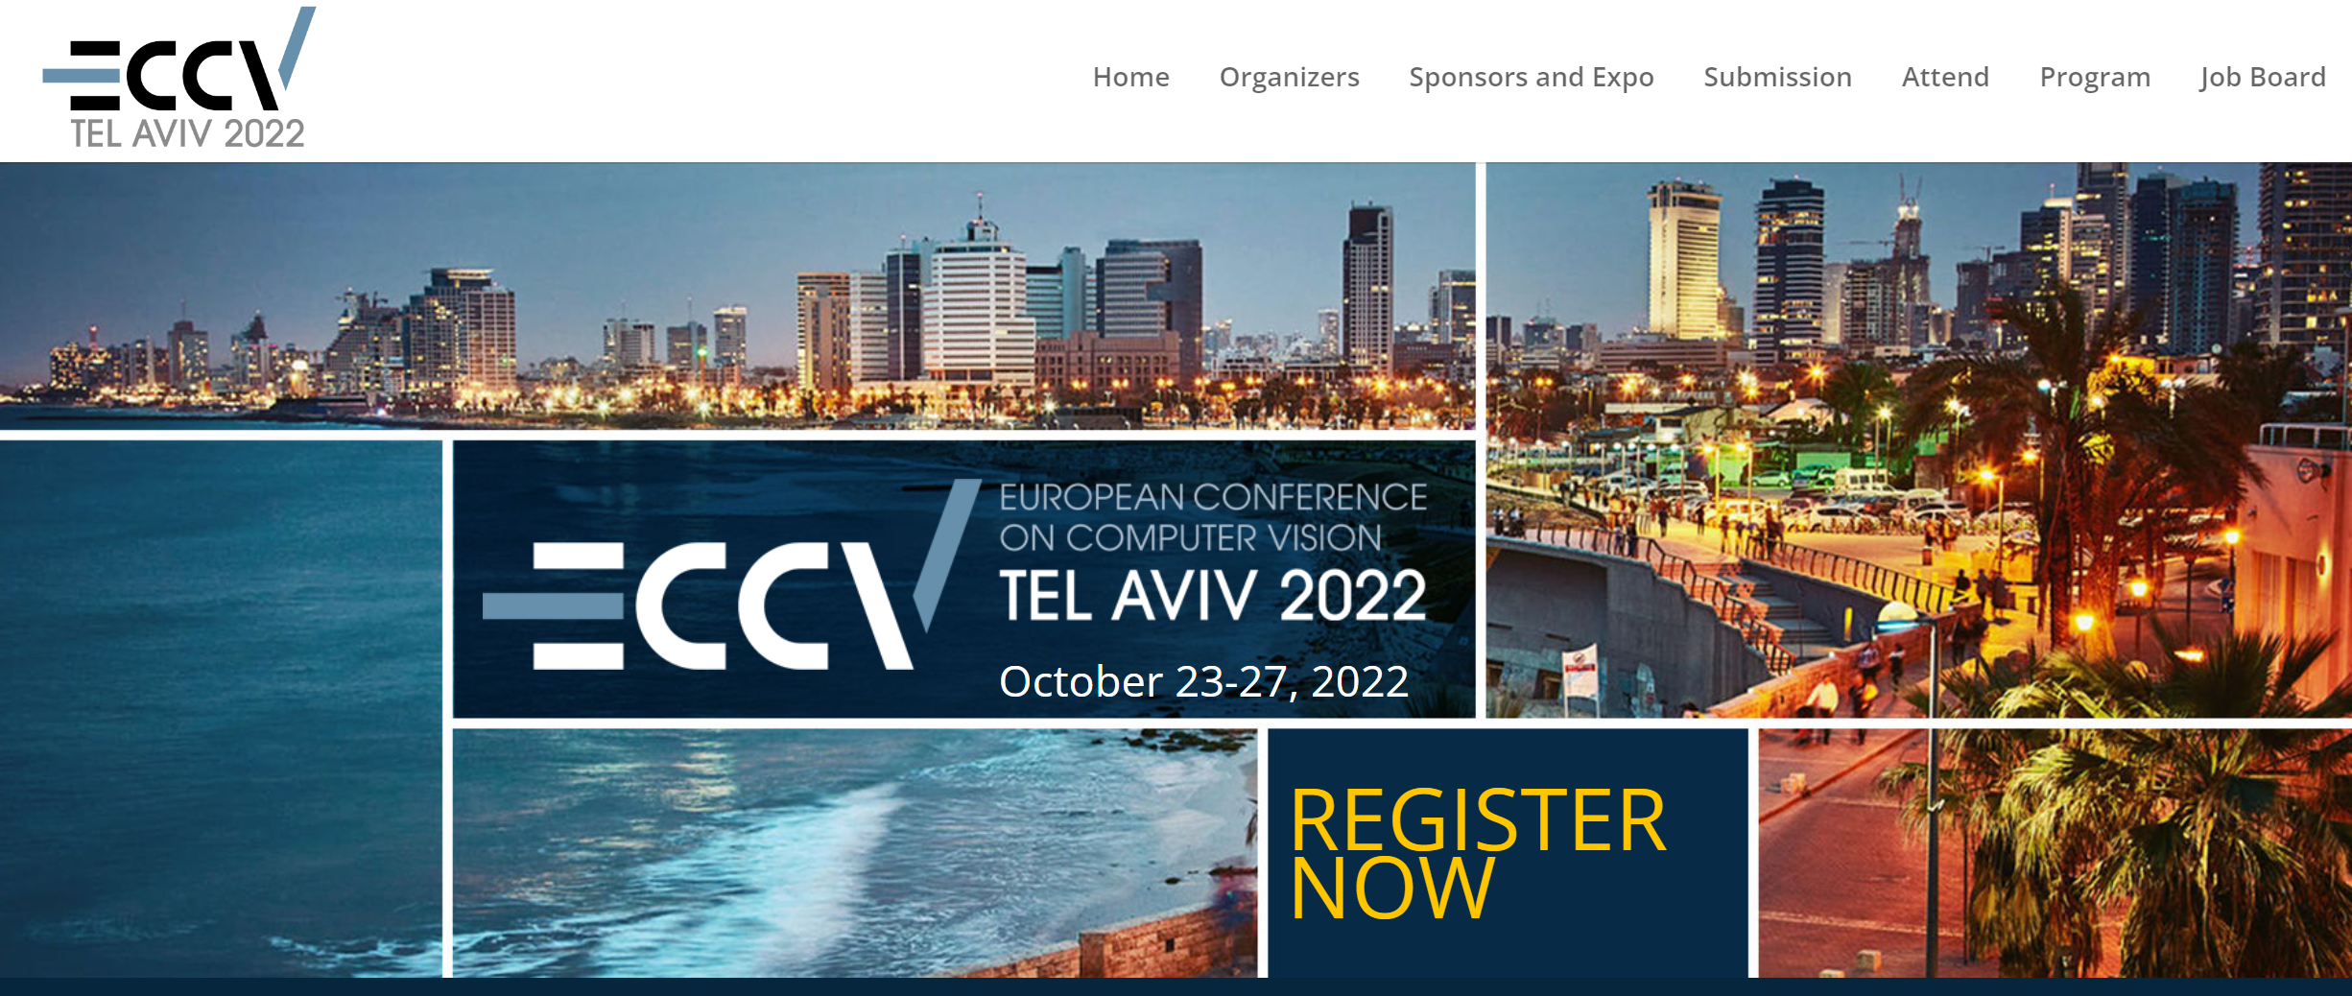
A bit about Gabe…
Gabe away in Term 1:
24-28th Oct
7th & 8th Dec
Part-time UCL
Part-time Niantic

Slide 20
What is computer vision?
Computer vision is concerned with developing artificial systems which extract information from image or video data.
Computer vision is a “new” academic field with impact throughout academia. There is now considerable interest from industry with many major players (Intel, Samsung, Microsoft, Google, Toshiba,...) establishing computer vision laboratories
Finally having impact on the real world (face detectors in cameras, robot-assisted surgery, humanitarian monitoring of video feeds, games)

Slide 21
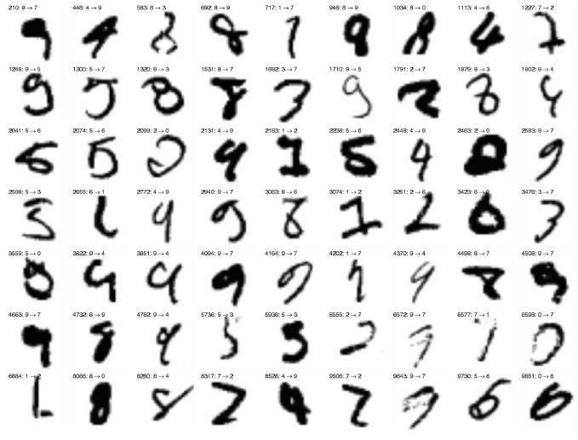
Classic Computer Vision
Most difficult MNIST test digits, from Belongie et al.
PAMI 2002

Slide 22
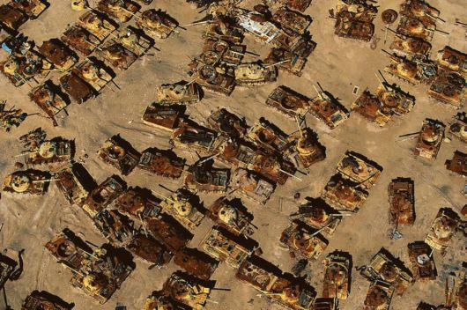
Classic Computer Vision
Iraqi tank graveyard in the desert near Al Jahrah, Kuwait, (© Yann Arthus-Bertrand)

Slide 23
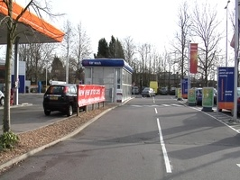
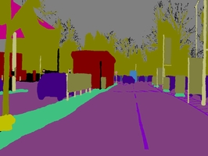
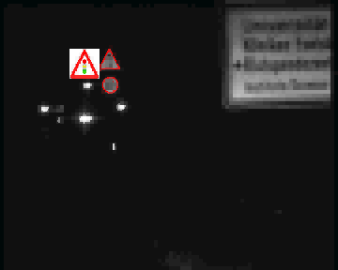
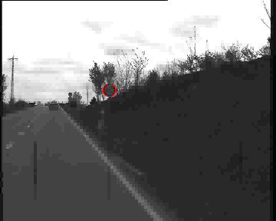
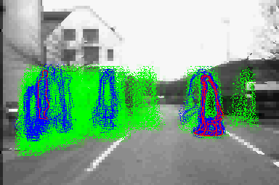
Computer Vision for the People
From
Dariu
Gavrila
?
Brostow et al. 2008

Slide 24
Big Goals of Computer Vision
Recognition
Character / Face / Object / Action*

Slide 25
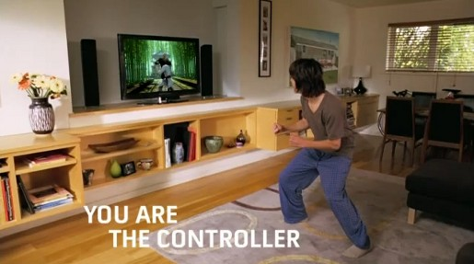
Big Goals of Computer Vision
Recognition
Character / Face / Object / Action*
Microsoft Kinect: Jamie Shotton, Andrew Fitzgibbon et al.

Slide 26
Big Goals of Computer Vision
Recognition
Character / Face / Object / Action
Reconstruction

Slide 27
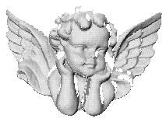
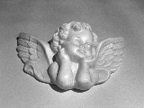
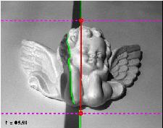
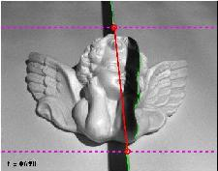
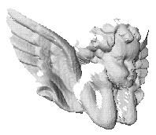
Big Goals of Computer Vision
Recognition
Character / Face / Object / Action
Reconstruction
2D input
→ 3D output
Project to extend Bouguet & Perona’s “3D Photography on your desk”, 1998 (web link)

Slide 28
Big Goals of Computer Vision
Recognition
Character / Face / Object / Action
Reconstruction

Slide 29
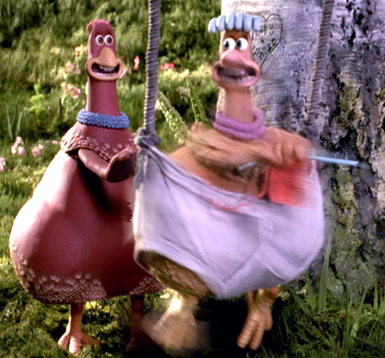
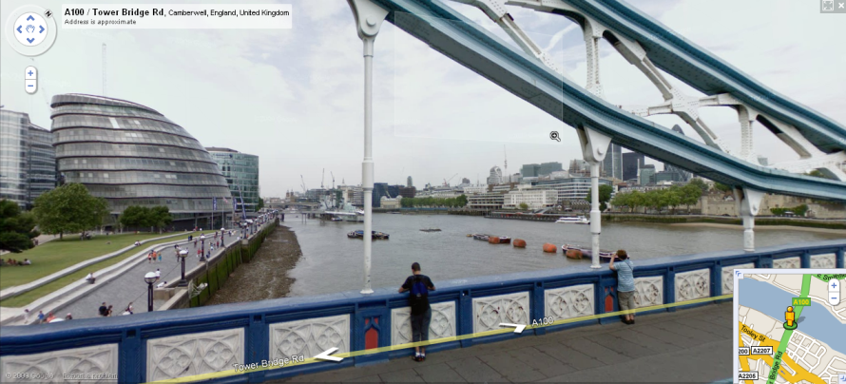
Big Goals of Computer Vision
Recognition
Character / Face / Object / Action
Reconstruction
Tracking
Segmentation
Navigation
Enhancement
Synthesis

Slide 30
Symbiotic Areas
Psychology
Film/Photography
Optics
Geometry
Computer Vision
Physics
H.C.I.
Probability
AI / M. Learning

Slide 31
Computer Vision Tasks
Tasks for computer vision might include:
Reconstruction - the attempt to build a three dimensional model of the scene from one or more images
Camera Tracking - identifying the movement of the camera relative to the scene in an image sequence
Object Detection - establishing that a certain type of object (e.g. a dog) is in the scene
Segmentation - establishing exactly which pixels belong to a certain object
Scene Parsing - establishing a complete understanding of a scene where we have information about what object is at each pixel and how these objects occlude each other

Slide 32
Computer Vision Tasks
Identity Recognition - having found an object (e.g. a face) draw inferences about whether it is a particular face
Image Enhancement - increase the resolution of the image (super-resolution), remove noise (denoising), or fill in missing areas (in-painting)
Generation - having learned something about a type of object or scene, use the model to generate new images of this type of object
Object Tracking - apply a dynamic model to follow an object and monitor changes in its appearance over time
Object Description - establish characteristics of an object once we have found it. For example, establish the sex, age or expression of a human face.

Slide 33
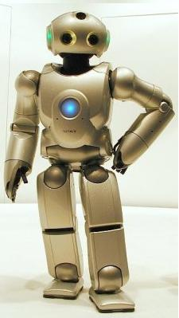
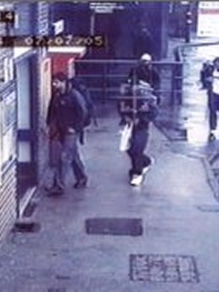
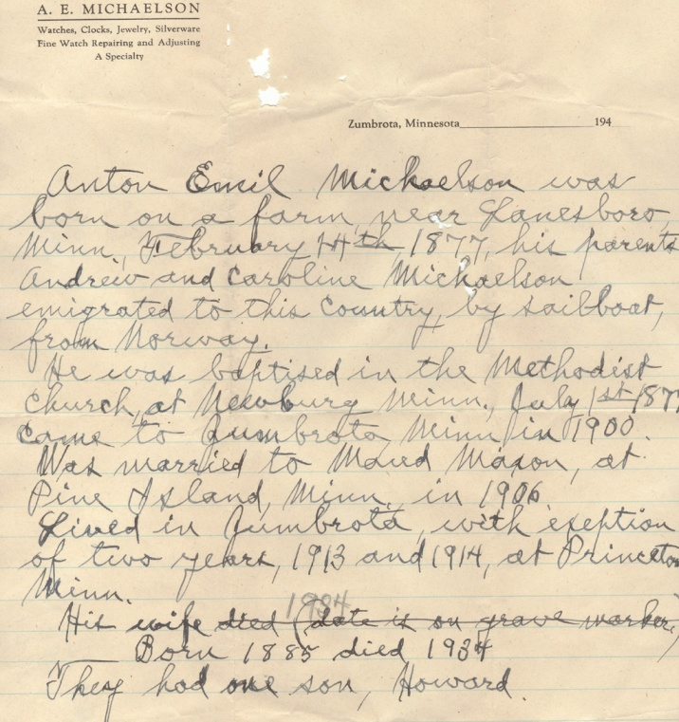
Applications of Computer Vision
Optical Character
Recognition
Robotics
Security

Slide 34
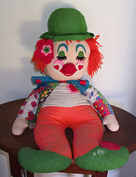
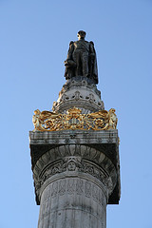
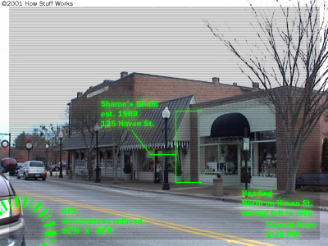
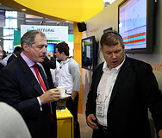
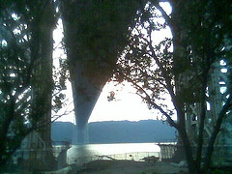
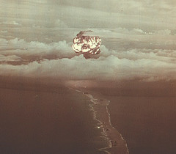
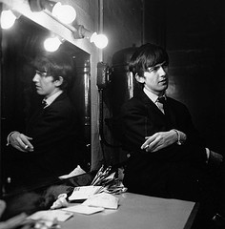
Applications of Computer Vision
Augmented Reality
Image Retrieval

Slide 35
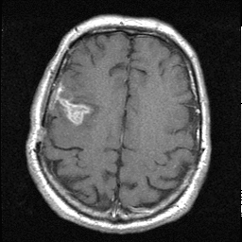
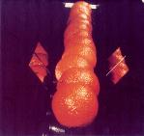
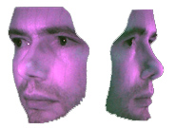
Applications of Computer Vision
Medical Image Analysis
Industrial Inspection
Model Building

Slide 36
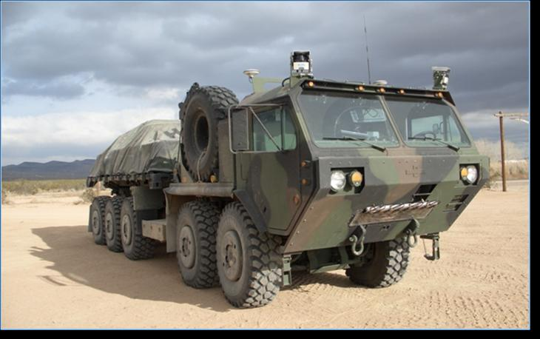
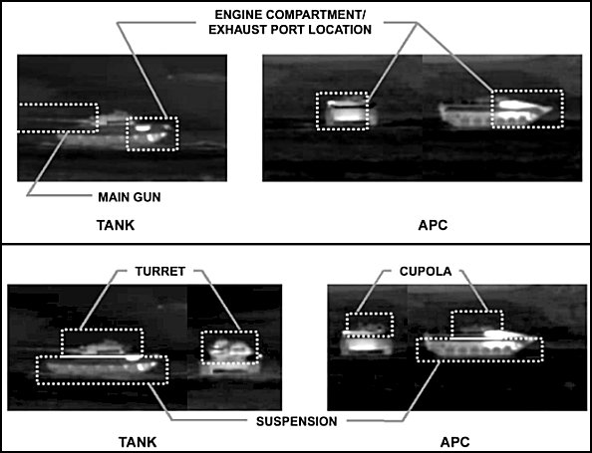
Applications of Computer Vision
Autonomous Vehicles
Military Applications

Slide 37
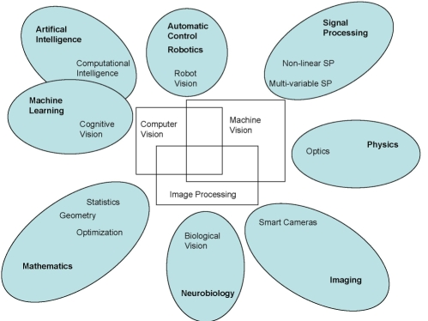
Relationship with other fields
Also a very close relationship with graphics – vision is inverse graphics!

Slide 38
Brief History of Computer Vision
1970s: the lack of computing power dictated algorithms, emphasis on low-level vision, and binary images; schism from other AI
1980s: close relationship with researchers investigating animal vision
1990s: geometry of multiple views of the same scene, and estimation of camera pose and scene geometry.

Slide 39
Brief History of Computer Vision
2000s: several trends have emerged
Machine learning and vision have grown much closer
Much more emphasis on benchmarking and quantitative evaluation
Trend toward larger training datasets
Learn features using convolutional NN’s
Re-union with other branches of AI
Opportunities to cope with fewer labels

Slide 40





What’s Wrong With Nearest Neighbors?
Are Parametric Models
Good or Bad?
(Ans: yes!)

Slide 41

Image Space vs Feature Space
Convolutional Neural Net (CNN) as encorder of features:
“Quick” visualization of 2D Convolution
Example of what filters are looking for

Slide 43
Why is computer vision hard?
1. Dimensionality of Input Space
Consider an RGB image at VGA (640x480) resolution with an 8 bit pixel intensity resolution (256 gray levels). The number of total possible images is 256^(640x480x3).
Conclusion: Almost none of the possible images has ever been seen!
(Perhaps all the pixels are not independent?)

Slide 44
Why is computer vision hard?
2. Vision is an inverse problem
The mapping from scenes to images is many to one: the data we receive is non-unique. How can we possibly establish what is out there?
3. Speed
VGA camera at 30Hz receives 27Mb per second of data – how can we process all this?

Slide 45
Some Mitigating Factors
We know a lot about the generative model (graphics)
We usually have a lot of prior knowledge about what we expect to see in the image (helps with non-uniqueness)
There is a large amount of training data readily available.

Slide 46
Course Overview
Probability
Joint probability
Conditional probability
Independence
Bayes’ rule
Common probability distributions
How to fit distributions to data
The multivariate normal

Slide 47



Course Overview
2. Machine learning for vision
Goal: infer the state of the world from observed data
Two approaches:
Discriminative: build probability model of the world and make parameters depend on the data
Generative: build a probability model of the data and make the parameters depend on the world. Use this model to infer probability of world.

Slide 48
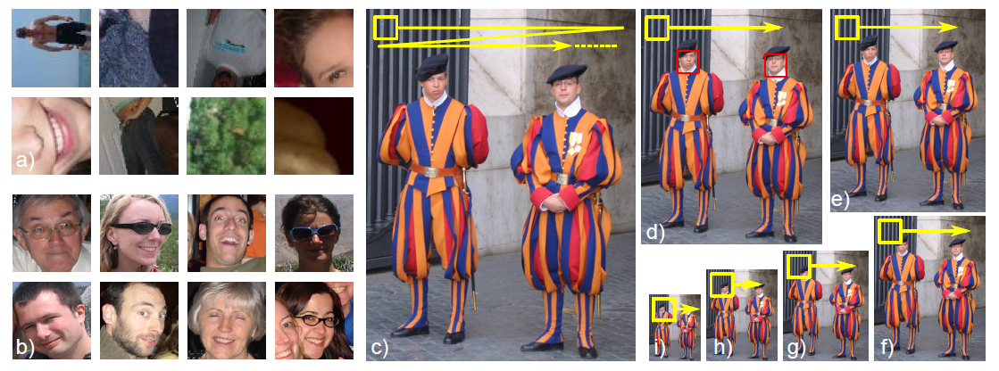
Course Overview
2a. Modelling complex pdfs (Generative)
Mixture models
t-distributions
Factor analysis
The EM algorithm

Slide 49
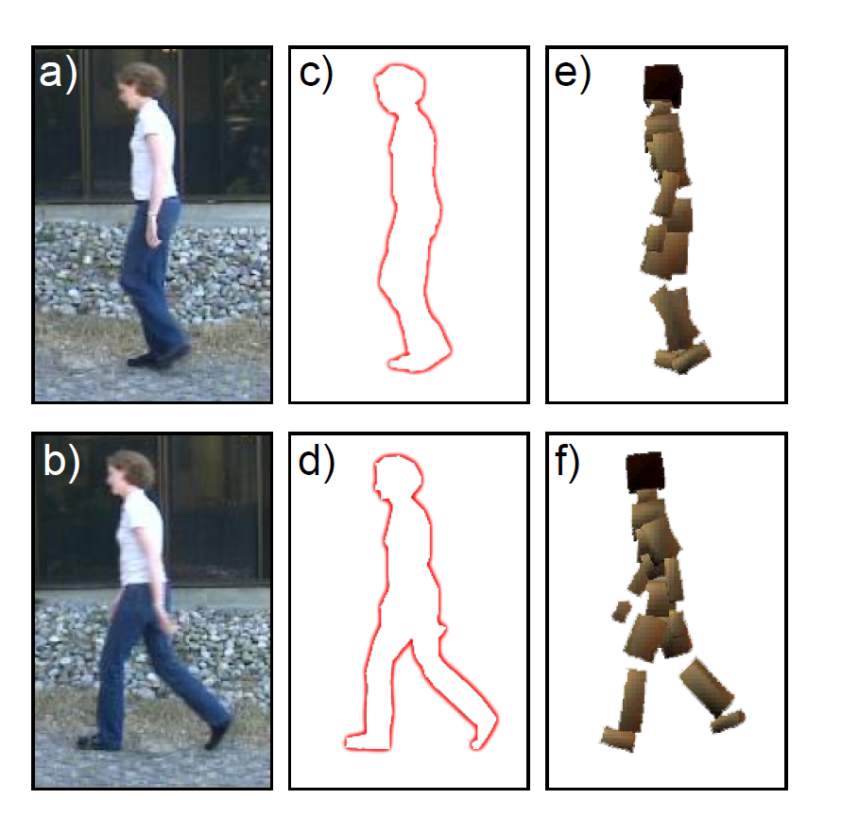

Course Overview
2b. Models for regression (Discriminative)
Linear & non-linear regression
Gaussian process regression
The relevance vector machine

Slide 50


Course Overview
2b. Models for classification (Discriminative)
Logistic regression
Gaussian process classification
Boosting and classification trees

Slide 51


Course Overview
3a. Connecting Models 1
Conditional Independence
Graphical Models
Inference on tree-structured models
Pictorial Structures

Slide 52
Course Overview
3a. Connecting Models 1
Undirected models
Markov random fields
Graph cuts

Slide 53


Course Overview
4. Models of Shape
Point distribution model
Active Shape Models
Active appearance models
Active Shape Models
Active Appearance Models

Slide 54


Course Overview
5. Tracking
The Kalman Filter
Extensions of the Kalman Filter
Particle Filtering
Examples of Tracking Objects

Slide 55









Course Overview
6. Face Recognition
Subspace models for recognition
Within- and between- individual variance
Recognition across pose
μ+2F(:,1)
μ+2F(:,2)
μ+2(F:,3)
vs.
μ+2G(:,1)
μ+2(G:,2)
μ+2G(:,3)
Face Models

Slide 56





Course Overview
7. Geometry of a Single Camera
Image transformations
How do 3d points project to pixels
Special cases of imaging
(A)
(B)
(C)
(D)
Augmented Reality Tracking
Image Mosaicing

Slide 57


Course Overview
8. Geometry of multiple cameras
Stereo vision
Epipolar geometry
Finding and matching distinctive keypoints
Shape from silhouette
Models from Sparse Stereo Vision
Shape from silhouette

Slide 58
Course Mailing
IMPORTANT!
Course information will be distributed via Moodle.
All announcements on Moodle will be assumed to have been received.

